Slide 1
Learning & Development Enabling development, Impacting growth…
Cognos 11 (IBM Cognos Analytics) – Training
Cognos Connection

Slide 2
Module Objectives :
What is Cognos Connection?
Schedule Reports
Organize Content with Folders
Customize Portal

Slide 3
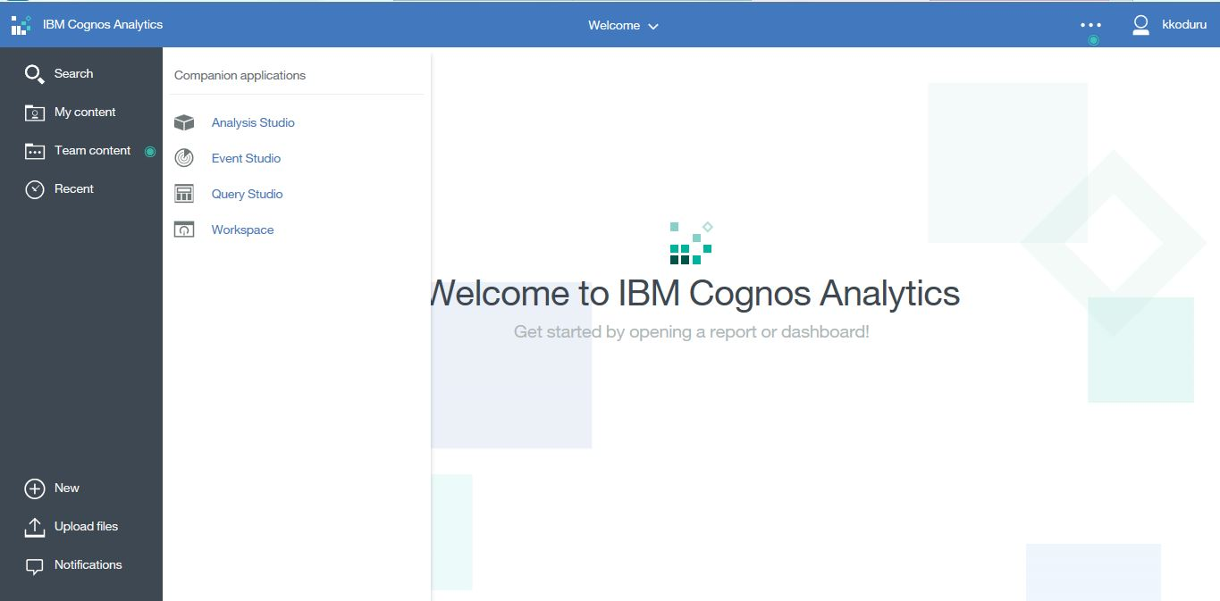
Cognos Connection
What is Cognos Connection?
Web portal provided with Cognos 11 where users have a single point of access to corporate data. Users can query, analyze and organize data, create reports, scorecards and events
User Interface
Access the Cognos Connection from the Cognos Analytics web portal.

Slide 4
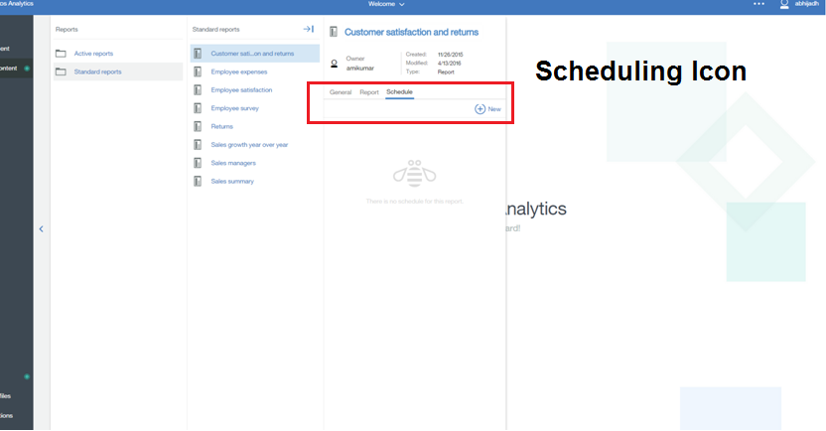
Schedule Reports
Steps :
Select the Scheduling Icon
Notes:
4
4

Slide 5
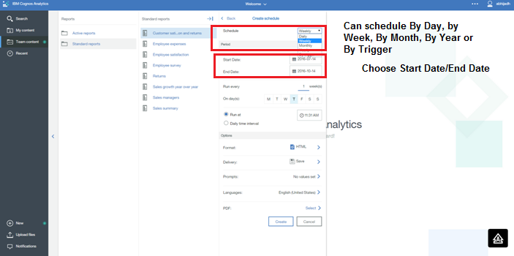
Schedule Reports
Steps :
Choose Frequency
By Day
By Week
By Month
By Year
Notes:
5
5

Slide 6
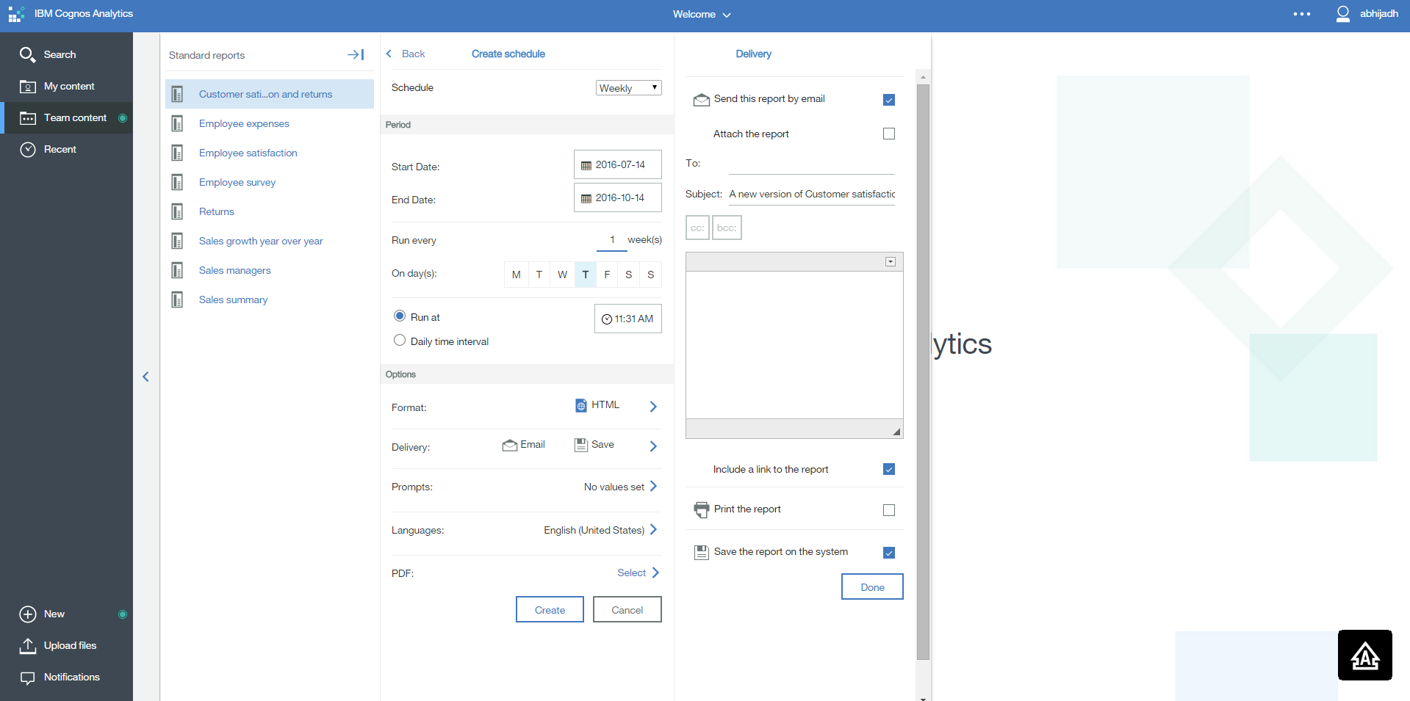
Schedule Reports
Steps :
Choose Start Date/End Date (can choose No end Date)
Choose Override the default values so you can choose format and delivery options
If you choose send report by email for delivery option, choose “Edit the Options”
Notes:
6
6

Slide 7
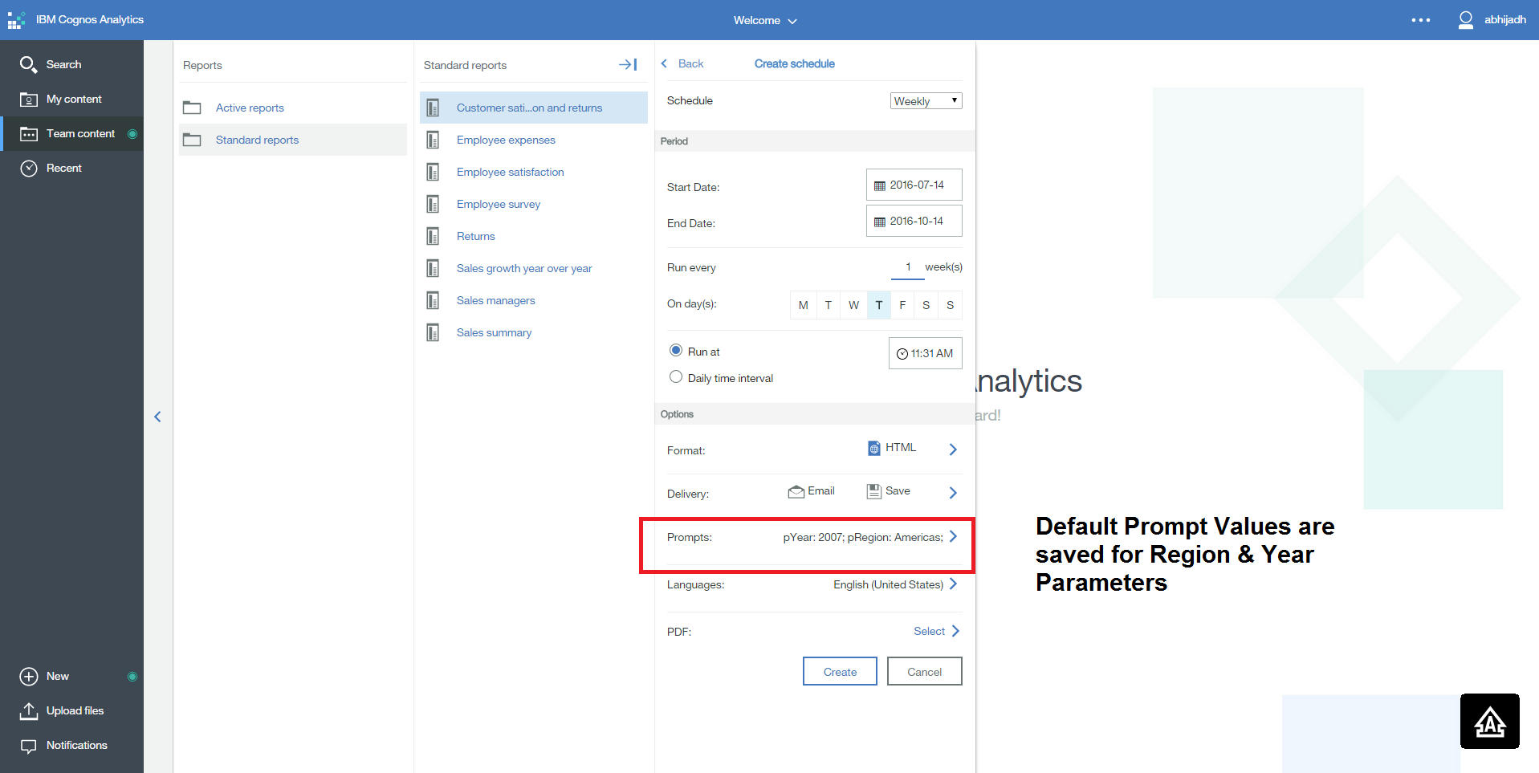
Schedule Reports
Steps :
If you want to have the report run with specific prompts, check “Override the default values” checkbox under Prompt values.
Click the “Set..” link
Prompts for the report will load - select the prompt values
Notes:
7
7

Slide 8
Organize Content with Folders
Notes:
8
8

Slide 9
Thank You
Review Date | 14-July-2016
Version | 1.0
Next Review Due | 14-July-2017

